Slide 1
Lecture 7
Nick Rugai PhD

Slide 2
Nested for loops
Rewrite the prime number function with for loop index printout.

Slide 3
Floor Division and Modulus
Converting minutes to hours:
105 minutes
105/60=1.75
105//60=1
The floor division operator, //, divides two numbers and rounds down to an integer
105-1*60=45
105%60=45
The modulus operator, %, divides two numbers and returns the remainder

Slide 4
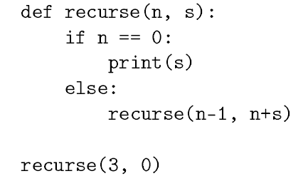
Infinite Recursion Issues
Infinite Recursion is a BAD thing!
Run the following:
def recursion():
Recursion()
Run recurse(3,0)
Run recurse(-1,0)

Slide 5
Arrays
An array is a variable that can hold more than one value.
cars = [“Ford”, “BMW”, “Chevy”]
For x in cars:
print(x)
cars [0] = “Toyota”
cars
len(cars)

Slide 6
Arrays
Cars.append(“Nissan”)
cars
len(cars)
cars.pop(3)
cars
cars.remove(“BMW”)
cars

Slide 7
Arrays
Write a function that finds the largest number in an array.
Write a function that splits an array at a determined spot and moves the two parts.

